Slide 1

Bank Marketing

Slide 2

Agenda
Introduction
Initial Observation
Data Understanding
Model Evaluation
Data Cleaning
New Model
Recommendations

Slide 3
Introduction
Data Set Information:
The data is related with direct marketing campaigns of a European banking institution. The marketing campaigns were based on phone calls. Often, more than one contact to the same client was required, in order to access if the product (bank term deposit) would be ('yes') or not ('no') subscribed.
Problem Statement:
Study the data, find data patterns and clean the data for further modeling to help the banking institution determine, in advance, clients who will be receptive to marketing campaigns.
Evaluate performance of the deployed model, state the evaluation metric used and suggest whether the bank ought to replace the current model (if applicable).

Slide 4
Initial Observation
Attribute | Description | Unique values | Type
age | Age | 78 | Numeric
job | Type of job | 12 | Categorical
marital | Marital status | 4 | Categorical
education | Education | 8 | Categorical
default | Has credit in default? | 3 | Categorical
housing | Has housing loan? | 3 | Categorical
loan | Has personal loan? | 3 | Categorical
contact | Contact communication type | 2 | Categorical
month | Last contact month of year | 10 | Categorical
day_of_week | Last contact day of the week | 5 | Categorical
duration | Last contact duration, in seconds | 1544 | Numeric
campaign | Number of contacts performed during this campaign and for this client | 42 | Numeric
pdays | Number of days that passed by after the client was last contacted from a previous campaign | 27 | Numeric
previous | Number of contacts performed before this campaign and for this client | 8 | Numeric
poutcome | Outcome of the previous marketing campaign | 3 | Categorical
emp.var.rate | Employment variation rate - quarterly indicator | 10 | Numeric
cons.price.idx | Consumer price index - monthly indicator | 26 | Numeric
cons.conf.idx | Consumer confidence index - monthly indicator | 26 | Numeric
euribor3m | Euribor 3 month rate - daily indicator | 316 | Numeric
nr.employed | Number of employees - quarterly indicator | 11 | Numeric
ModelPrediction | Results from a current model used | 38444 | Numeric
y | Has the client subscribed a term deposit? | 2 | Categorical
Total # of instances = 41188
Total # of attributes = 22 Including the output variable(Y)
Class distribution(y): yes = 11.26%, no = 88.74%
Total # of Numeric Type = 11
Total # of Categorical Type =11

Slide 5
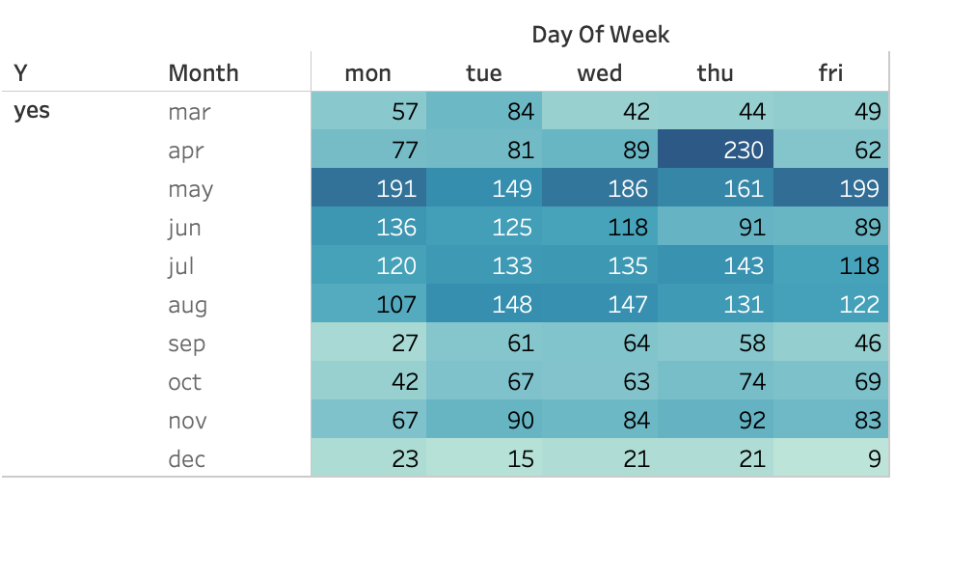
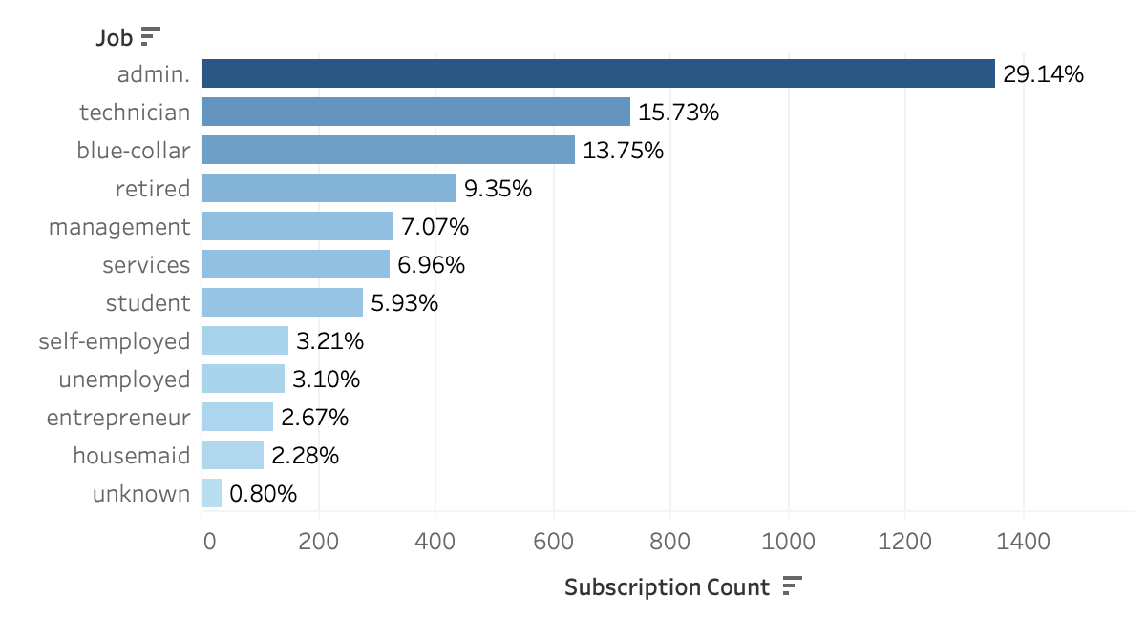
Data Understanding with respect to subscribers
Apr-Aug subscription rate =70.87%
Highest subscription job types are:
Admin(29.14%)
Technician(15.73%)
Blue-collar(13.75%)
Month/Day of Week
Job

Slide 6
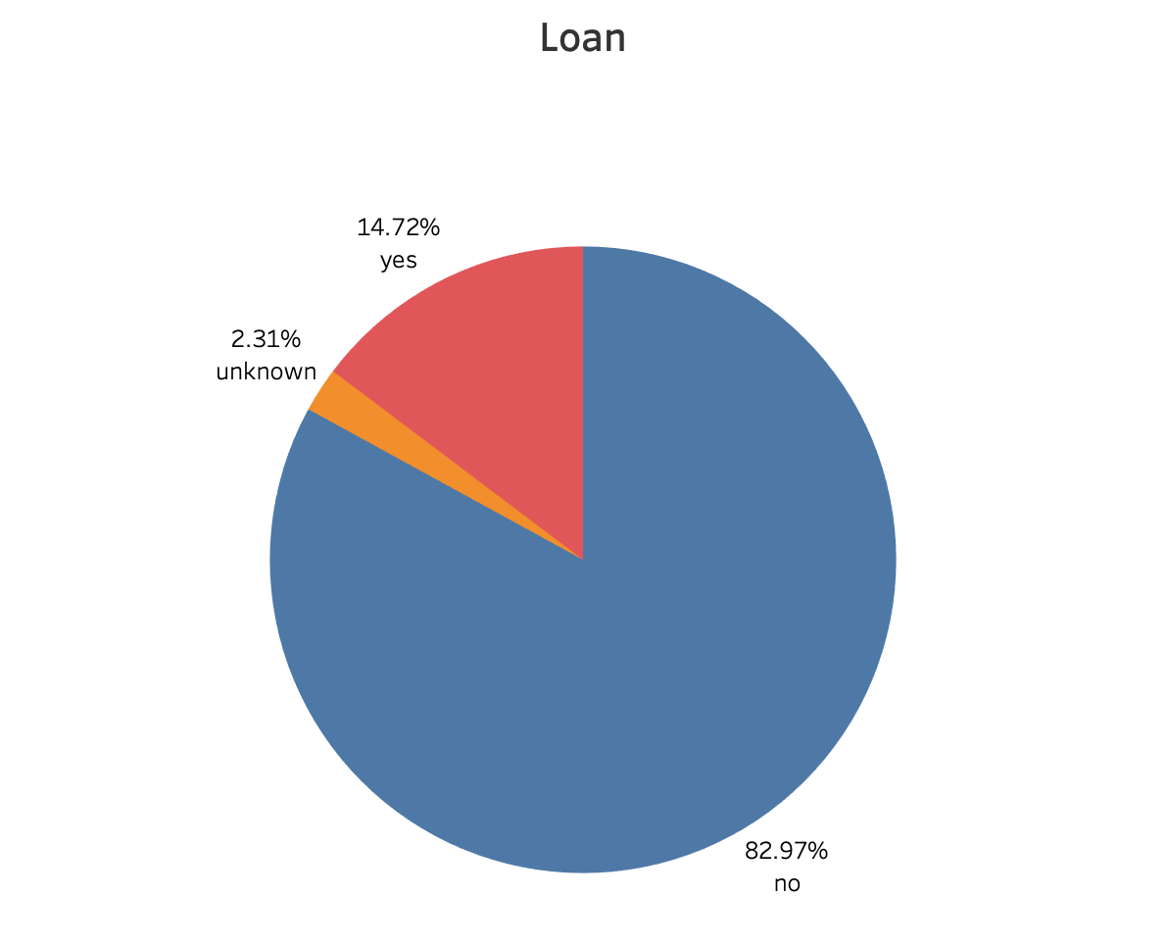
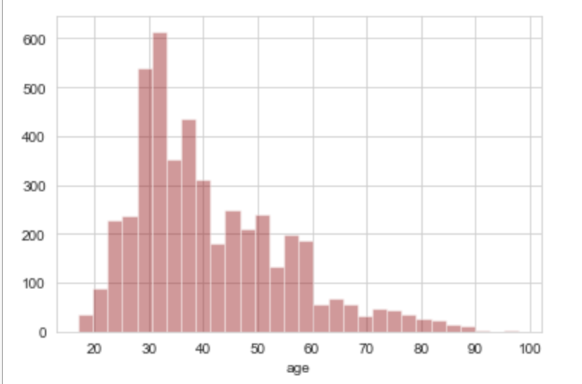
Age
82.97% of the clients who subscribed had no personal loan
High subscription rate is distributed around age group of 25-60

Slide 7
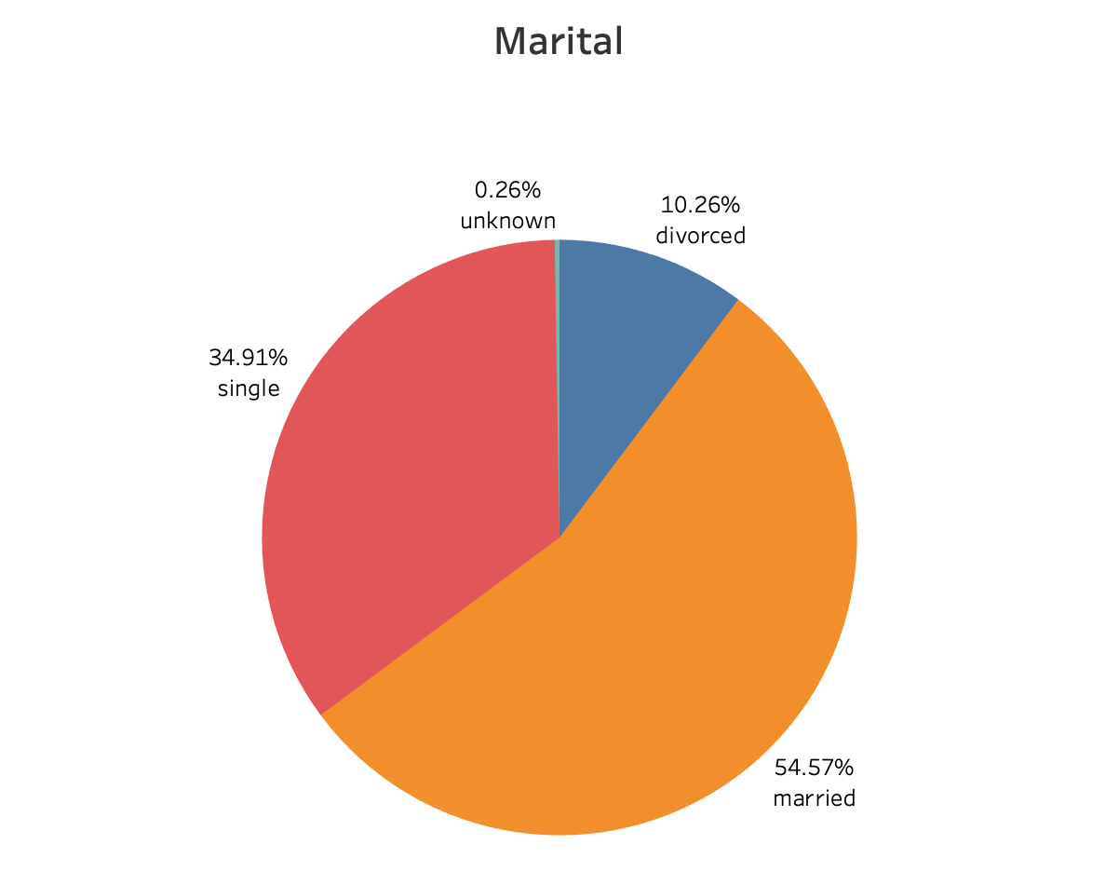
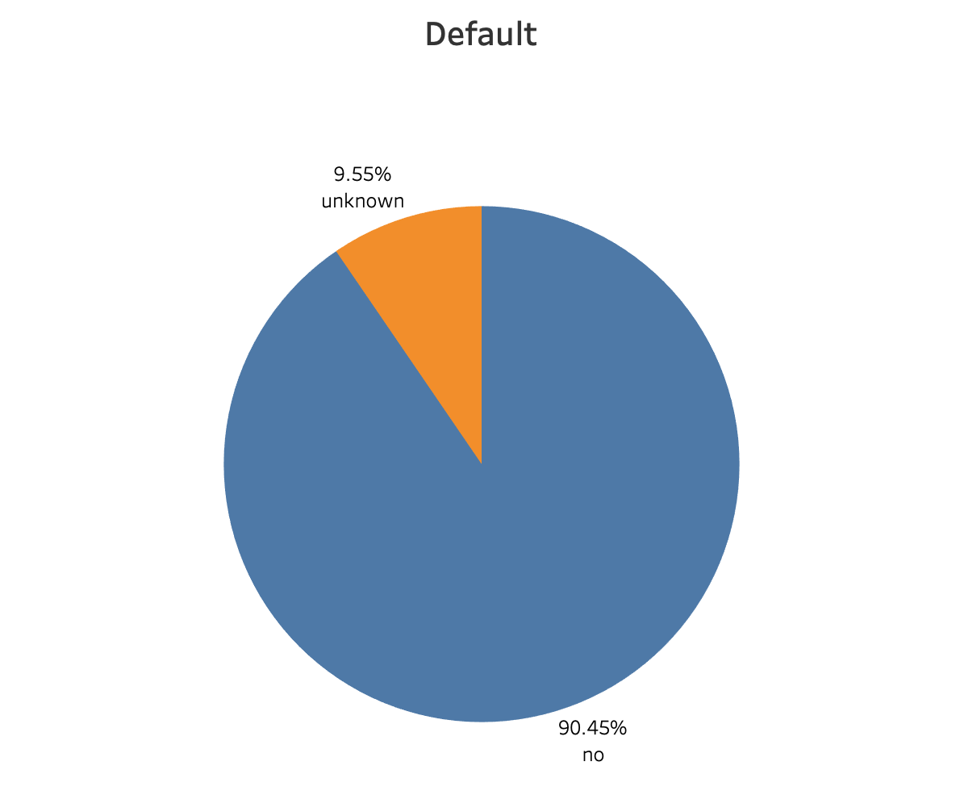
54.57% of the clients who subscribed were married
90.45% of the clients who subscribed had no credit default

Slide 8
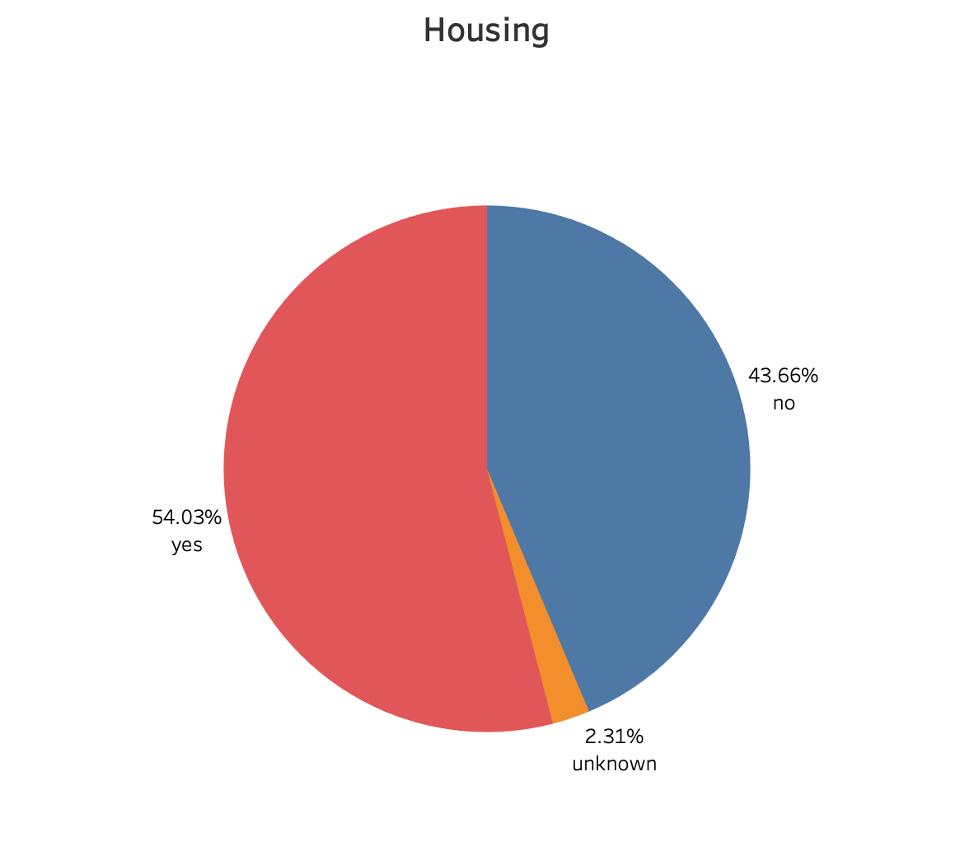
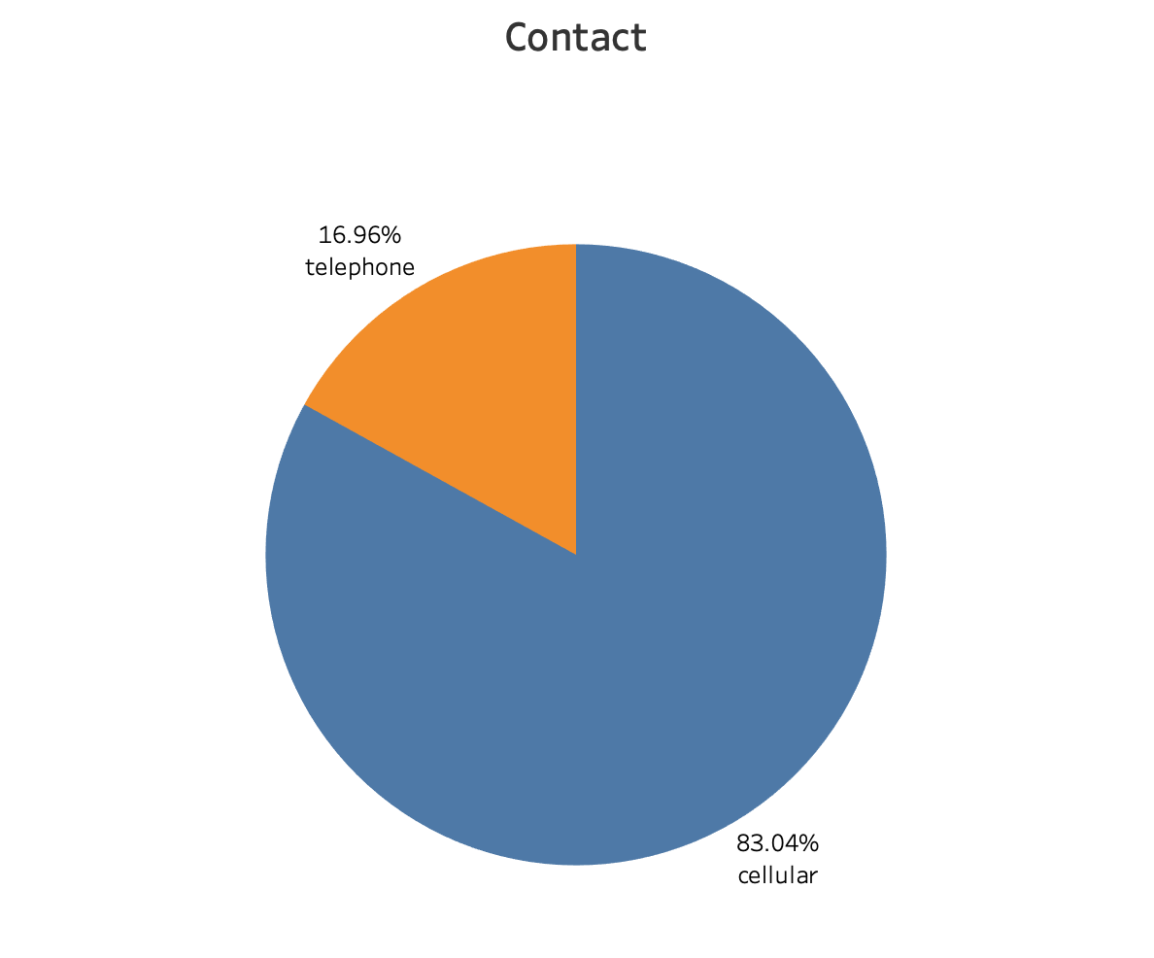
54.03% of the clients who subscribed had housing loan and 43.66% had no housing loan
83.04% of the subscribers were contacted through cellular

Slide 9
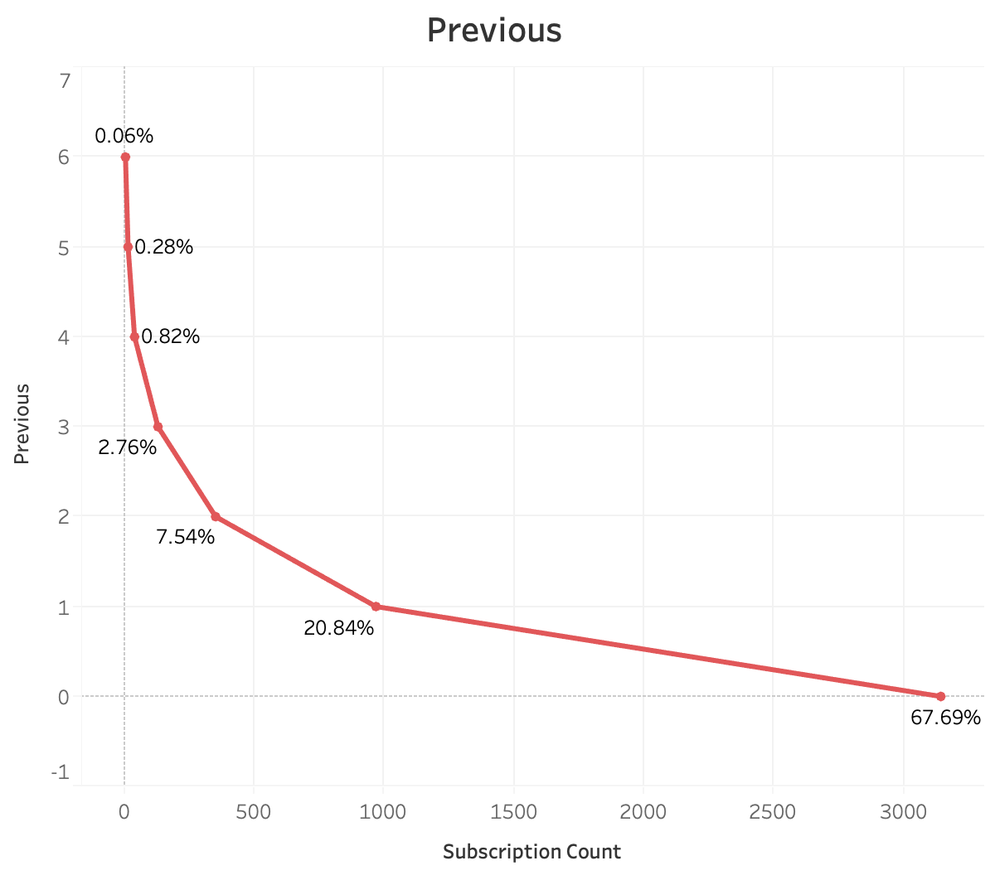
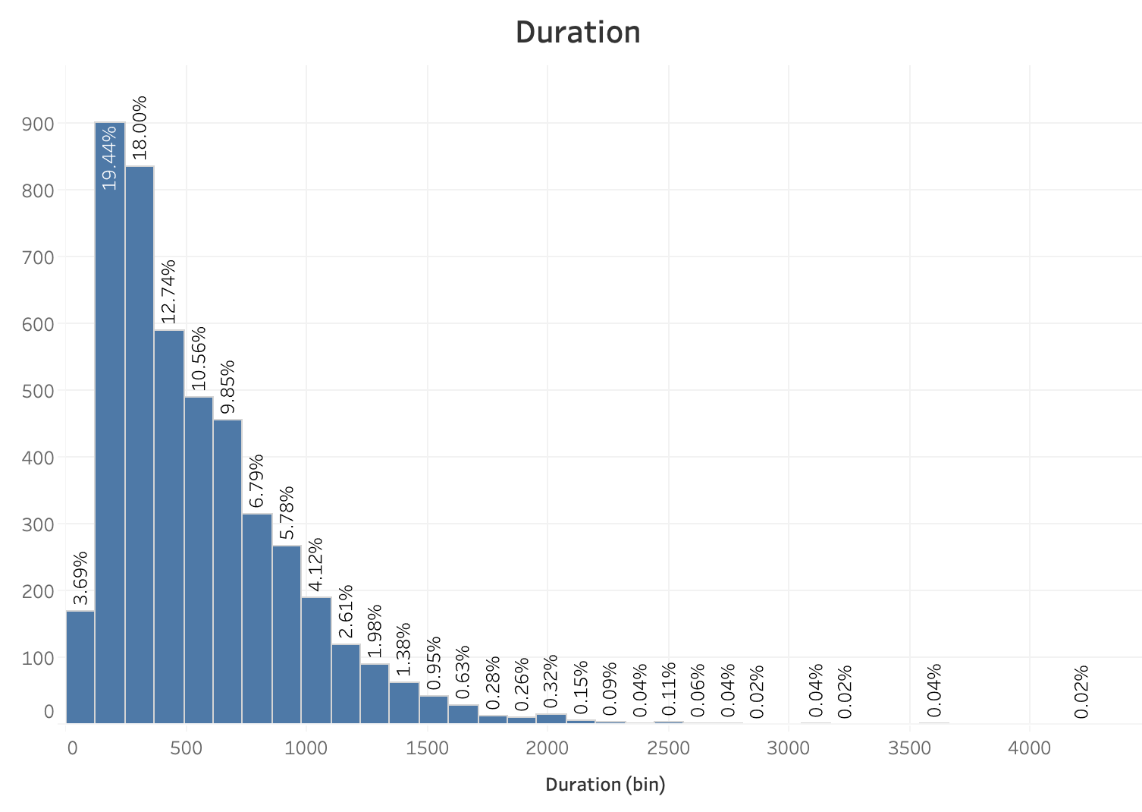
67.69% of the subscribers were not contacted before this campaign for the subscription
Duration 122-610 sec have the highest count of subscription

Slide 10
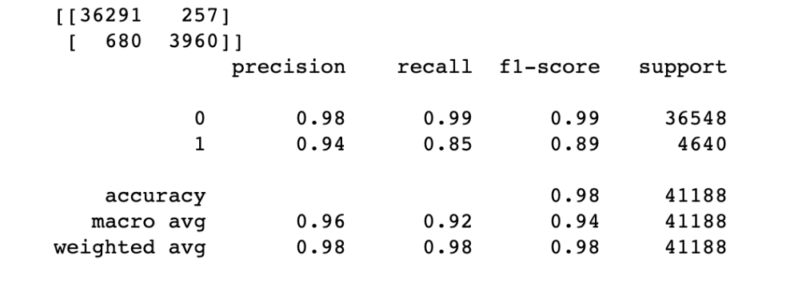
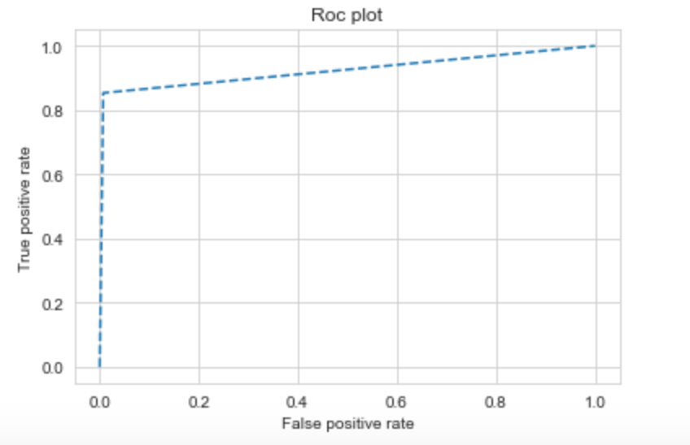
Model Evaluation
Evaluation Metrics used:
Precision=0.93
Recall=0.85
F1-Score=0.89
AUC =0.92
We want high sensitivity (Recall) as the cost of making a call is much lower than misclassifying a potential subscribers as non –subscribers

Slide 11
Data Cleaning
Attribute | Values
Marital | Alone(divorces, single, unknown) = 0 | Couple(married) = 1
Age | <=21:0 | 21-30:1 | 31-50:2 | 51-65:3 | >65:4
Job | white-collar(admin, management) = 0 | blue-collar(blue-collar, housemaid, services, technicians) = 1 | owners(self-employed, entrepreneur) = 2 | no jobs(retired, unemployed, unknown) = 3 | students = 4
Default | yes =1 | (no, unknown) = 0
Housing | yes =1 | (no, unknown) = 0
Loan | yes =1 | (no, unknown) = 0
Contact | telephone=0 | cellular=1
Previous | 0:0 | >0:1
Month | (apr, may, jun, jul, aug) = 0 | (mar, sep, oct, nov, dec): 1
Day_of_week | mon=0 | tue=1 | wed=2 | thu=3 | fri=4
Education | Basic(all basics)=0 | School(high.school, professional.course, university.degree) = 1 | No education(illiterate, unknown) = 2
Poutcome | nonexistent=0 | success=1 | failure=2

Slide 12
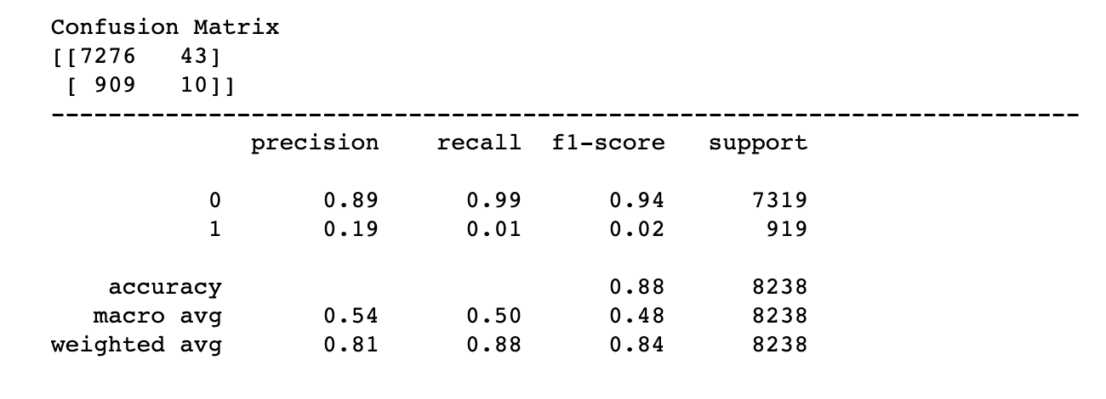
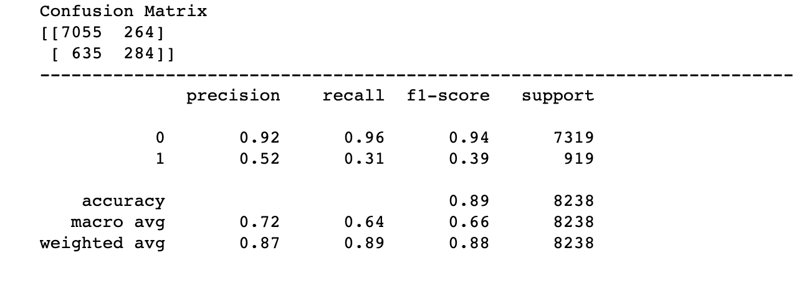
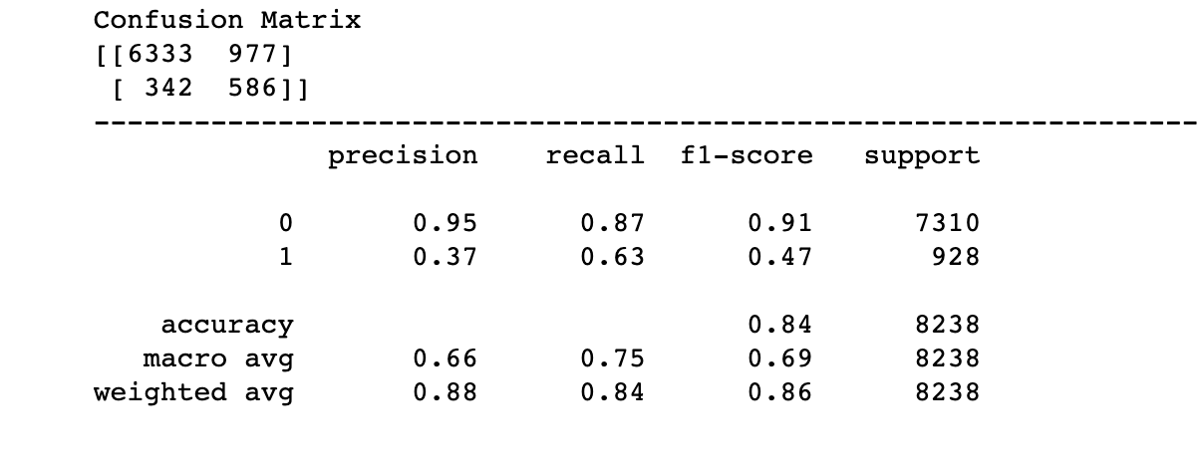
New Model
Logistic Regression
Decision Tree
SVM

Slide 13
Recommendations
Significant Variables | Recommendations
Duration, Mode of contact: | Try to engage customers and have longer calls. Use cellphone as the mode of contact.
Campaign: | Target new customers. Majority of the subscribers were not contacted before.
Age: | Target more customers between the age of 25 to 60
Employment: | Target more customers of job type admin, technician, blue-collar
Month: | Target to contact customers between Apr and Aug
Default, Loan: | Target customers with no default and no loan

Slide 14
Thank you

